Slide 1
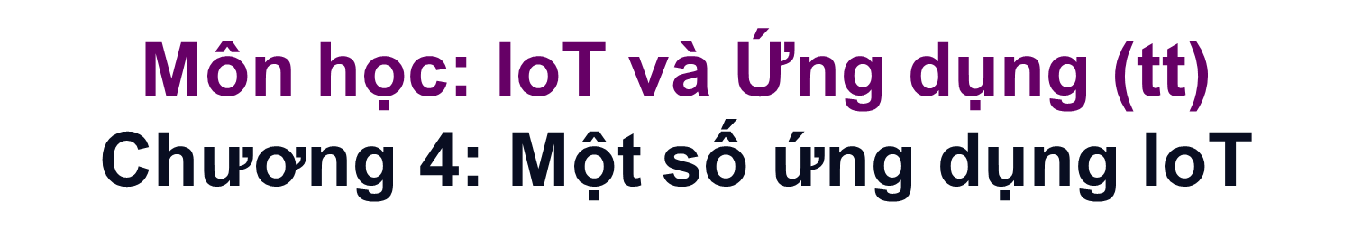
Nhà thông minh (Home Automation)
Thành phố thông minh (Smart city)
Giám sát chất lượng không khí và tiếng ồn
Nông nghiệp thông minh
Nhà máy thông minh
Thiết bị đeo thông minh hỗ trợ theo dõi sức khỏe

Slide 2
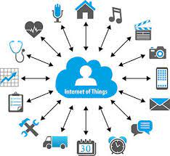
Sensors for IoT

Slide 3

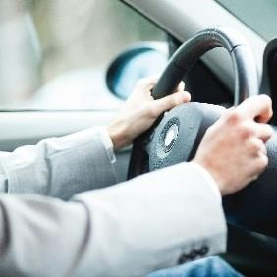


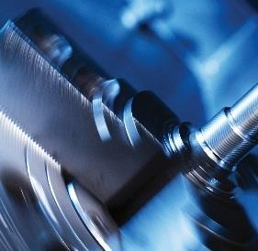



ams at a glance
Our business
Focus on high performance sensor solutions
Sensor solutions, sensor ICs, interfaces, related software
Small, low power, highest sensitivity, multi-sensor integration
Best-in-class solutions for leading OEMs
Smart Phones & Tablet
Automotive
Our end markets
Consumer & Communications (C&C)
Automotive, Industrial, Medical (AIM)
Wearables
Industrial
By the numbers
1000+ engineers
21 design centers, 3 manufacturing locations
35+ years of design and manufacturing know-how
9000+ employees worldwide
8,000+ customers
Financials
− Revenues H1 2017 EUR330.8m/$359.1m
− Revenues 2016 EUR549.9m/$608.7m
Smart Home & Buildings
Medical
2

Slide 4

Outline
ams at a glance
IoT starts with Technology (HW/SW)
IoT starts with useful applications
IoT needs data security!
IoT needs sensors…
Sensors for Mobiles
Sensors for Wearables
Sensors for Home Automation
Sensors for Building Automation
Conclusion / outlook
The Internet of things (IoT) is the network of physical devices, vehicles, home appliances, and other items embedded with electronics, software, sensors, actuators, and network connectivity which enable these objects to collect and exchange data.
This includes:
Autonomy:
Sense – analyze – initiate actions
3

Slide 5
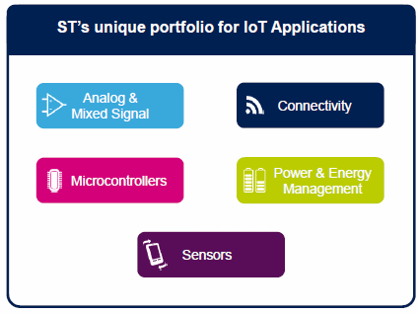
IoT starts with Technology
Hardware
Analog and mixed-signal components
Connectivity ➔ Each thing is uniquely identifiable & addressable. And is able to sent and receive data.
Microcontrollers
Power and energy management
Sensors
Actuators
Software
The IoT allows objects to be sensed (sensors) or controlled (actuators) remotely
Analysis of data (at local scale)
Take informed decisions to take actions
Data
Requires standardization:
Data structure: data type, time + location organization needed
Communication protocols
Services
Analysis of data (at meta / mega scale)
Portfolio for IoT applications:
Create www statistics for reference
With help of internet give advise.
With use of a reference database
www.st.com
4

Slide 6





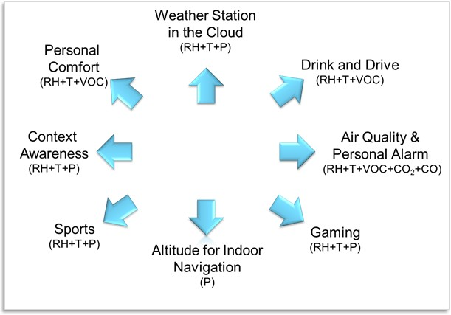
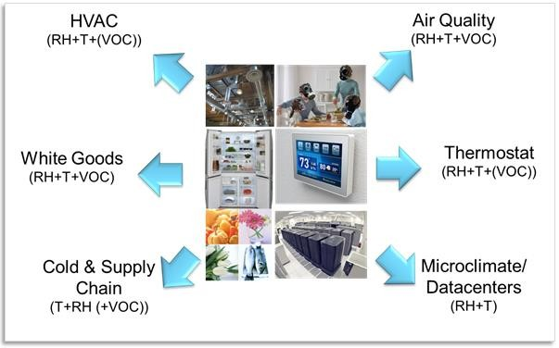
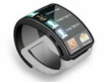
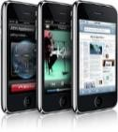
IoT starts with useful applications
Use Cases – environmental sensors
Mobile and wearable
Home Building Automation / Internet of Things
www.ams.com
5

Slide 7


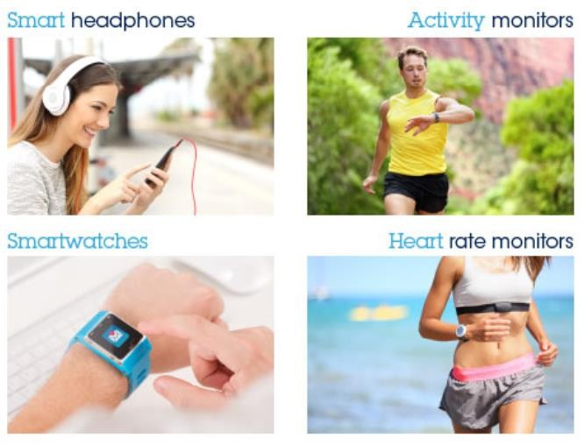


IoT starts with useful applications
Everything becomes smart:
Smart grids / power management
Smart homes
Smart buildings
Intelligent transport
Smart cities
Digital health
Smart wearable
Smart environment
Smart enterprise
Smart farming
Transport
smart traffic control, smart parking, electronic toll collection systems, logistic and fleet management, vehicle control, and safety and road assistance.
Medical:
e-remote health monitoring and emergency notification systems. Personal medical advisor. Wearable heart monitors, vitality sensors. Quantified self, connected health.
Agriculture:
temperature, rainfall, humidity, wind speed, pest infestation, soil humus content or nutrients, Greenhouses: – amount of light + color of light, …
Counter side:
Internet of Shit:
No added value:
- e.g. moving display from coffee machine to mobile phone
Not working software
Not setting up good security standards
- …
− …
www.st.com
Internet of Living Things Internet of Medical Things
Internet of Health Things at Home Industrial Internet of Things Internet of XXXXXX Things.
6

Slide 8
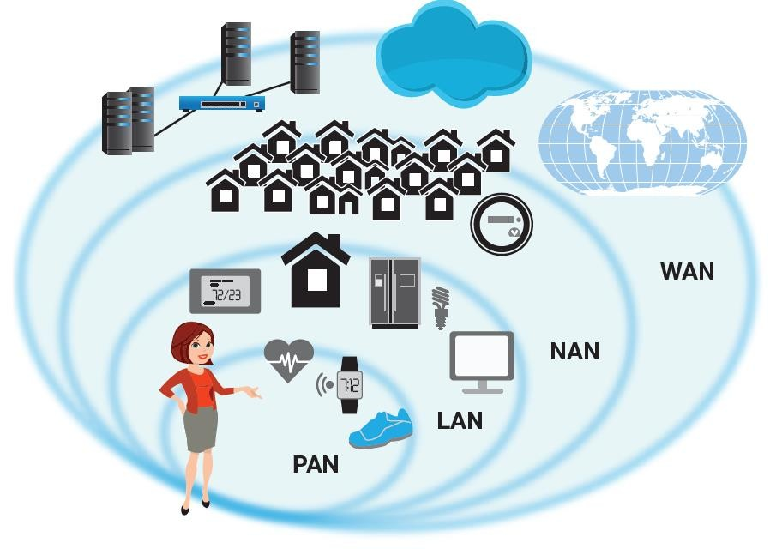
IoT needs data security!
IoT and data mining are inherently incompatible with privacy.
IoT Security Foundation (IoTSF) was launched on 23 September 2015.
Data security
IoT companies should ensure that data collection, storage and processing would be secure at all times.
Companies should adopt a “defence in depth”
approach and encrypt data at each stage.
As long as IoT devices & data are on the internet. Software must be maintained to control it.
Data permission
users should have control over their data usage at all times.
Data limitation
Only data that is needed should be collected and
stored for a limited time.
White paper www.ti.com ₇

Slide 9









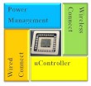




IoT needs sensors…
Market trends & technology needs
Performance
→ New/better/more sensing functions
→ Smarter and/or more autonomous systems
→ Through model & logic, ideal & good sensors again
→ Self calibration & sensor to sensor corrections
→ Low power (battery applications)
Standalone Sensors
Integrated Multi-Sensors
TREND
Size and cost:
→ Small enough to enable mobility
→ More and more functions per unit area
→ Thinner devices
5 e-senses
Smart Sensor Systems
Miniaturization of sensors:
Bulk properties of classic sensors, replaced by calculating & modelling power of chip.
Bulk = ideal,
Miniaturization may make sensor less-ideal.
ASIC makes sensor ideal again.
Combined sensors:
The input of one (T) sensors, helps to improve the
other sensor (RH)
Miniaturized, integrated sensors
→ Monolithically
→ Wafer stacking (3D integration)
→ Wafer Level packaging
8

Slide 10

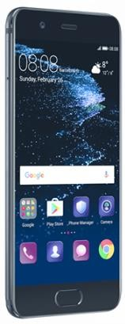
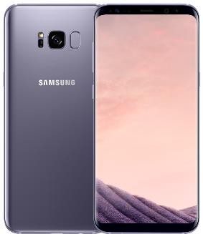
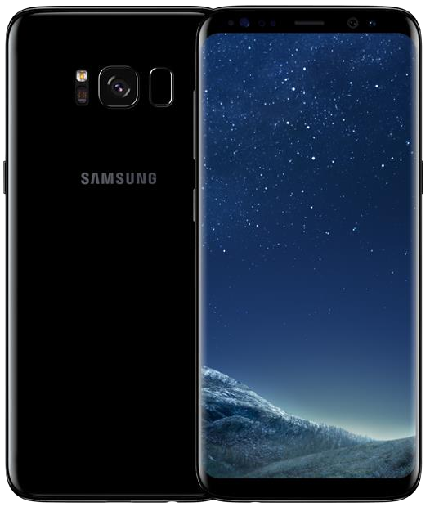
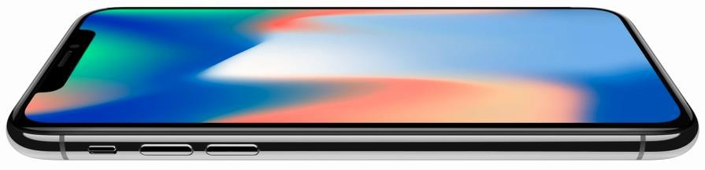
Sensors for Mobiles
Nr of sensors in a smartphone:
Face recognition, finger print, pattern, password, pin,
iris scan
 | 2007 | 2014 | 2021
IR Sensor |  |  | 1
RGB |  |  | 1
Laser ranger |  |  | 1
Gas sensor |  |  | 1
Pressure sensor |  |  | 1
Relative Humidity |  | 1 | 1
Heart Rate Monitor |  | 1 | 1
Fingerprint |  | 1 | 1
Magnetometer |  | 1 | 1
Accelerometer | 1 | 1 | 1
Proximity | 1 | 1 | 1
ALS | 1 | 1 | 1
CIS 3D - ToF |  |  | 1
CIS 2D | 1 | 2 | 3
Microphone | 1 | 3 | 4
Temperature | 1 | 1* | 1*
Total = | 6 | 12 | 20
Driving forces for market integration:
Sensor price
Value adding applications and use cases
Must haves are:
Performance
Good sensor, self calibration, reliable
Small form factor
Low power
New trends:
Smart phone as a HUB for e.g. vitality
sensors to www & cloud databases.
www.consumer.huawei.com/nl/ – P10
*) Yole Developpement 2017
9
www.apple.com – iPhone X
www.Samsung.com - Galaxy S8

Slide 11
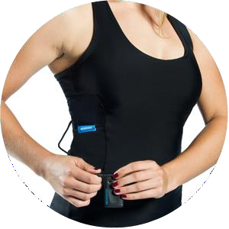
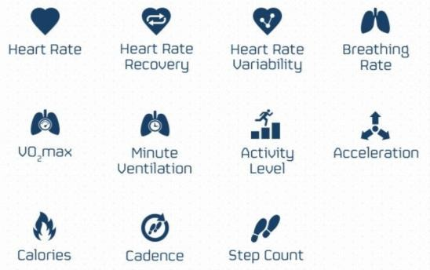
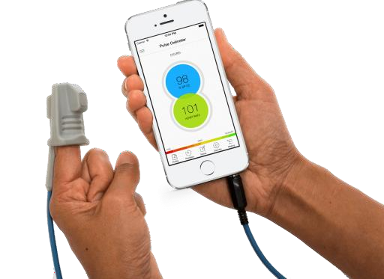
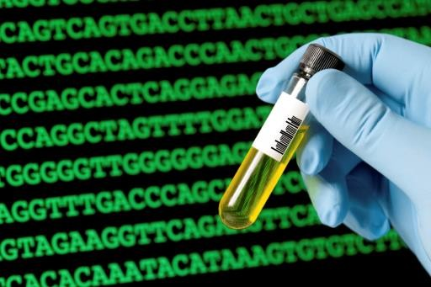
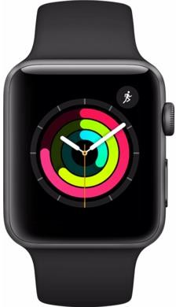
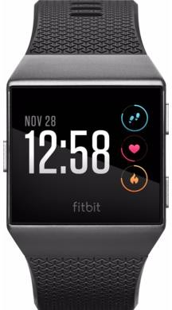
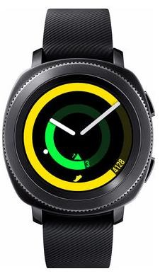
Sensors for Wearables
Worn on the body and in contact with the body
Smart watch,
wrist band,
clothes,
shoes,
etc.
Vitality sensors
Sensors supporting Personalized Medicine: e.g. PoC
www.hexoskin.com
http://medicalfuturist.com/6- surprising-trends-shaping-the-future- of-pharma
https://www.amazon.com/Wearable- Technology
Apple iWactch3
Fitbit Ionic
Samsung Gear Sport
10

Slide 12
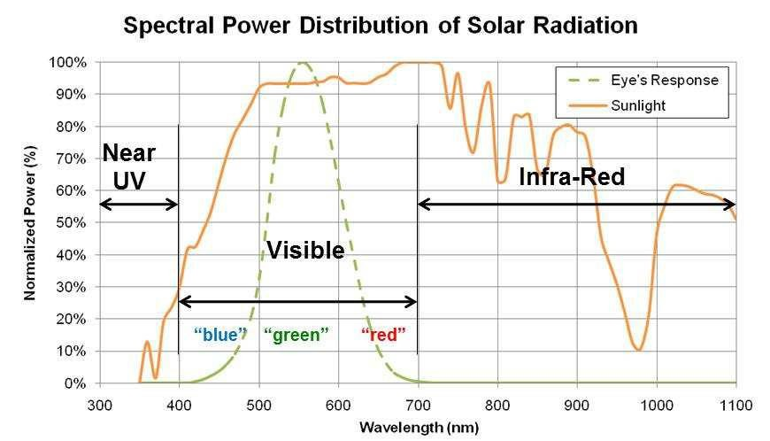
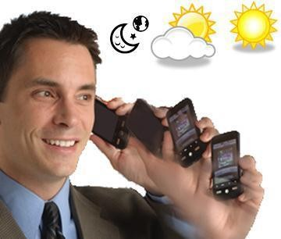
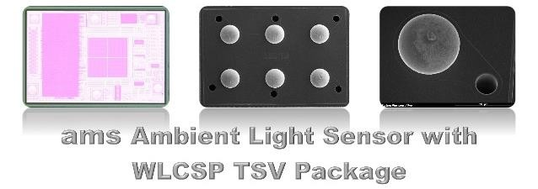
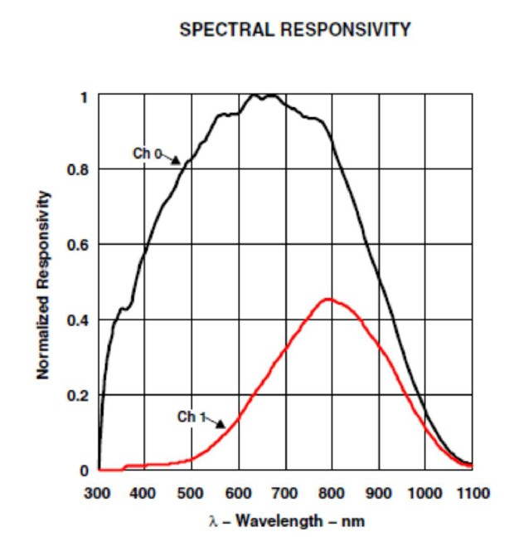
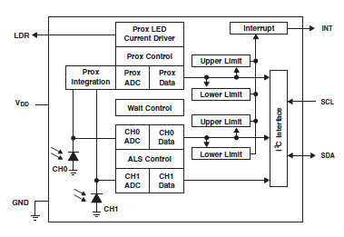
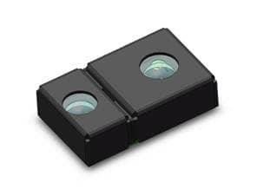
Ambient Light Sensors
Adjust screen intensity
Proximity detection to switch off screen
Dual diodes
11

Slide 13

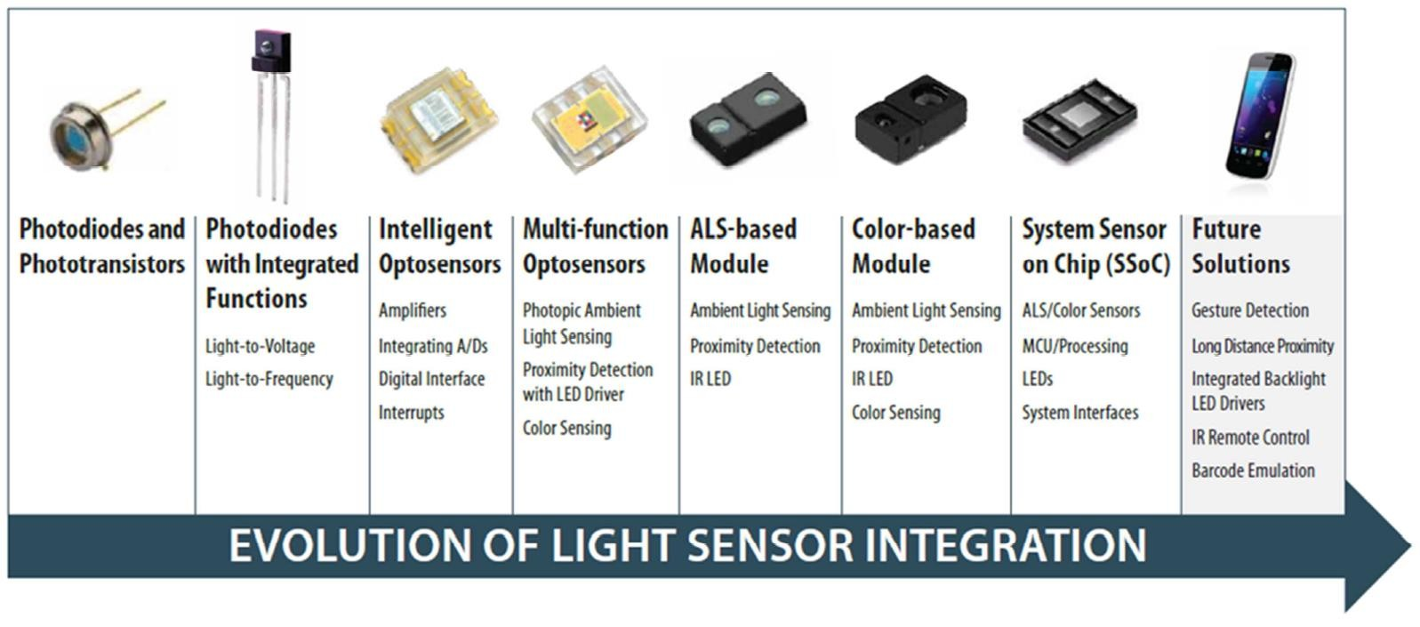
Light sensor evolution:
12

Slide 14
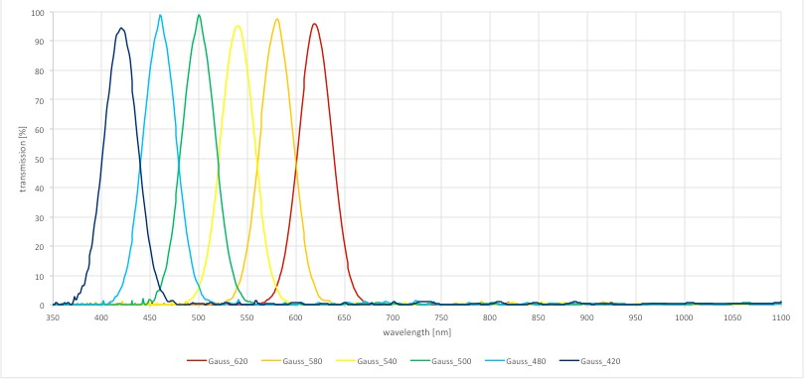

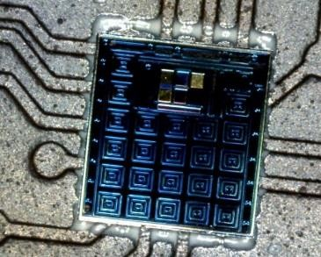
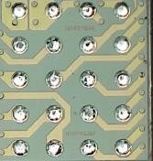
True color & Multi-spectral sensors
6-channel device with various choices of passband filters for different
applications ; SiP or 3D/TSV
Interference Filter options
XYZ-NIR UVAB
6-channel VIS +IR 6-channel VIS
…. and more
Quad Sensor Analog Front End
Spectral Sensing Engine
Communication/Network Interfaces
LED
UART
BLE I/F
/I²C
SPI
PROM
6-channel photosensor AS726x - architecture
6-channel photosensor AS726x - Top view and TSV/WLP bottom view
13

Slide 15



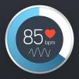
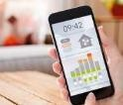
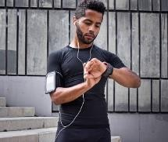
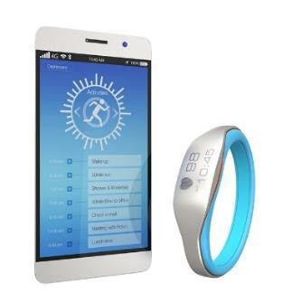

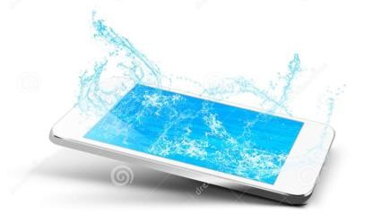
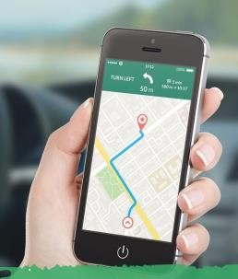
Mobile and Wearable Solutions
Key Use cases and Value Proposition
In- and outdoor air quality Monitor
Fitness & Personal Health
Improve life quality
Environment Comfort & Wellbeing awareness
Increase personal effectiveness and sleep quality
Reduce risks of chronic
diseases
Personal Safety
Performance report
optimization
Improved calorie consumption calculation
Water splash detection
GPS enhancement
Improve waterproof phone performance by settings optimization in water submersion (e.g. camera, touch screen, audio)
Failure prevention or guarantee
voidance
Improve dead reckoning
Low power indoor navigation
14

Slide 16
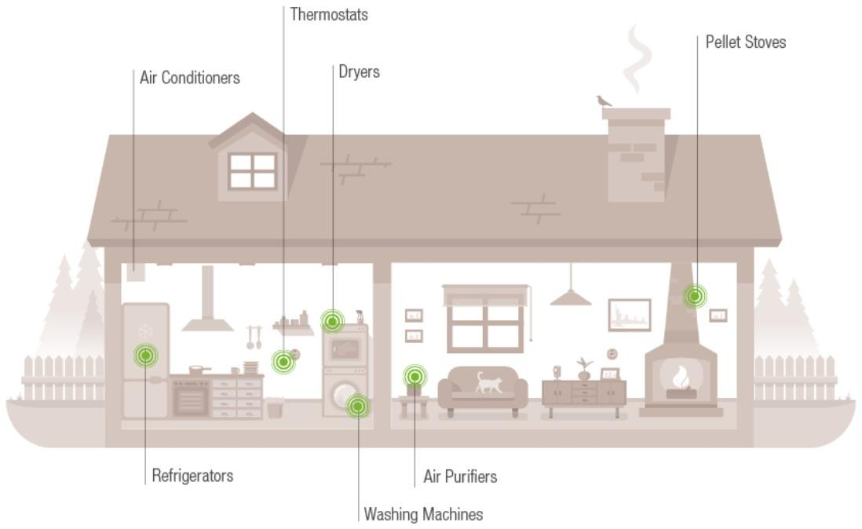
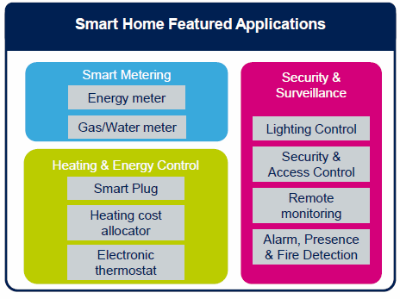
Sensors for Home Automation
Smart Home
Energy: solar panels, geothermal
heat
Smart appliances
Smart lighting
Presence detection
Air Quality
www.sensirion.com
Temperature and comfort
Healthy Home
Dust, Particular Matter, gases
Safe Home
Intrusion detection
CO, fire detection
www.st.com
15

Slide 17
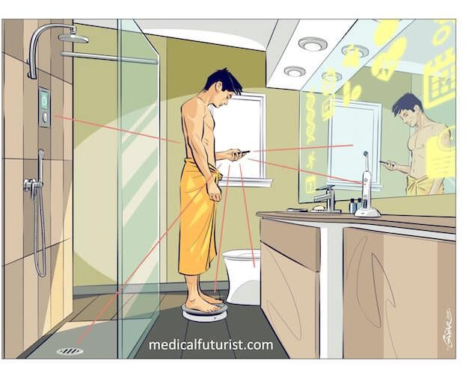
In Home: ‘Bathroom’ automation
Smart environment
light intensity & color
comfort: temperature, humidity
air quality
Smart mirror
Screen, indicates news,
Body vitality, BMI, etc
Smart balance
BMI, trends of …
Smart tooth brush
senses mouth hygiene
Smart toilet
as health monitor
Smart shower
eco-friendly
waste analysis
16

Slide 18
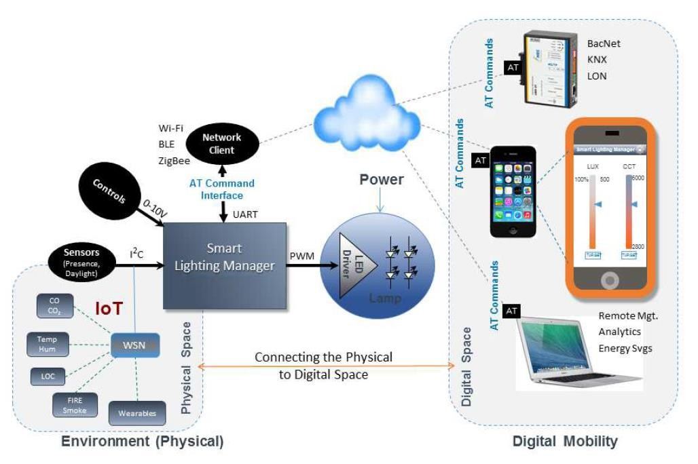
Sensors for Building Automation
Energy neutral
Smart Lighting
Health environment
Comfort
O2 & CO2 levels
Dust
gasses
17
White Paper: ams_TA_Internet_of_Awareness_in_Smart_Lighting_Systems_EN

Slide 19

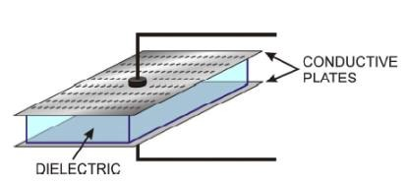

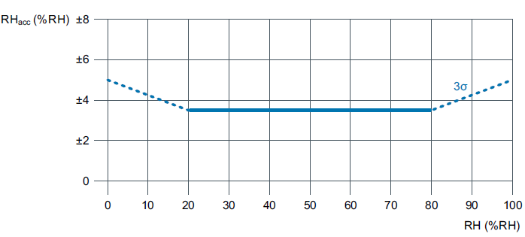
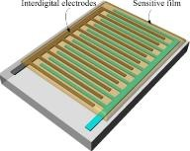
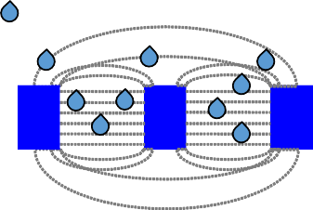

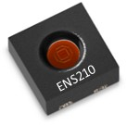




Relative Humidity
Operation principles
Parallel plate configuration
Interdigital configuration
polymer
DRY POLYMER (RH=0%):
RH > 0%:
MTP Memory
Humidity sensor
Controller
I²C
Interface
SDA
SCL
Temperature sensor
APB
18

Slide 20

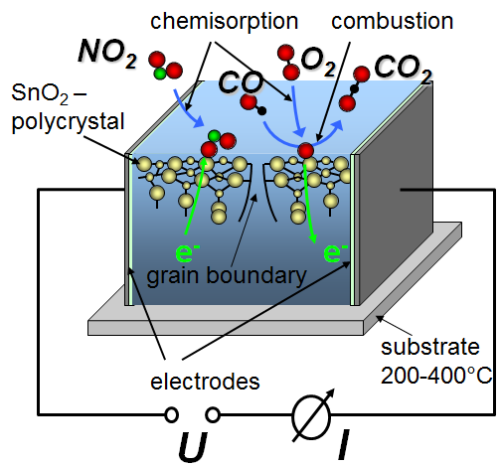
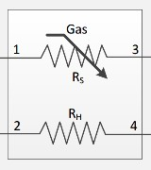


Gas Sensor: MOx semiconductor
MOx semiconductor
Crystalline material
Porous structure formed by “sintering” metal oxide powder
Electrical conductivity increases with temperature
Metal oxides behave as n-type or p-type semiconductors
Sensing resistance
Heater
Membrane
Metal Oxide
Heater
Semiconductor Classification | Example Material | Reducing gas response (eg CO) | Oxidising gas response (eg NO₂)
n-type | SnO₂ | Reducing resistance | Increasing resistance
p-type | Cr₂O₃ | Increasing resistance | Reducing resistance
19

Slide 21







Sensor Fusion Software
Compensation Overview
sensor in a cavity inside the phone
Thermal inertia
Thermal contact with the device reduces the speed of adaptation to changing ambient temperature.
sensor
sensor
gas molecules
Slow sensing due to the thermal inertia
Inaccurate sensing due to thermal interference
Slow sensing due to the diffusion / adsorption
Thermal interference There are many components producing heat inside a mobile
device, e.g. display or processor. The generated heat warms up the device and the sensor.
Temperature measurement inside a mobile phone with sudden T change from 30 °C to 20 ° C
Diffusion/adsorption/desorption When the ambient humidity changes, the diffusion process to the inside of the device can be slow.
Furthermore, internal components might adsorb/desorb the humidity,
e.g. the material of printed circuit boards.
20

Slide 22
Sensors for Mobile, Wearables, Home & Building Automation
 | 'Basic' Sensor type => Use Case Domains
Mobiles & Wearables
 | Phone calls, voice recognition |  |  |  |  |  |  |  |  |  |  | X
 | Photo camera |  |  |  |  |  |  |  |  |  |  |  |  |  |  | X
 | Face recognition |  |  |  |  |  |  |  |  |  |  |  |  |  |  | X |  |  |  | X
 | Screen intensity adjustment |  |  |  |  |  |  |  |  |  |  |  |  |  |  |  | X
 | Proximity measurement |  |  |  |  |  |  |  |  |  |  |  |  |  | X |  |  | X |  | X
 | Screen orientation | X
 | Location, GPS | X | X | X | X
 | Environmental information |  |  |  | X | X | X | X |  |  |  |  |  |  |  |  |  |  |  |  |  |  | X
 | Heart Rate monitor |  |  |  |  |  |  |  | X |  |  |  |  |  | X |  |  | X
 | True color |  |  |  |  |  |  |  |  |  |  |  |  |  |  |  |  |  | X
 | Vitality information, Glucose, .. | X | X | X | X | X |  | X | X | X |  |  |  |  |  |  |  | X |  |  |  | X
 | Personal Health - Quantified Self | X | X | X | X | X |  | X | X | X |  | X |  |  |  | X |  | X | X |  |  | X
Home & Building Automation
 | Temperature & comfort |  |  |  |  | X | X
 | Air Quality |  |  |  | X | X | X | X |  |  |  |  |  |  |  |  |  |  |  |  |  |  | X
 | Smart Lighting |  |  |  |  |  |  |  |  |  |  |  |  |  | X |  | X |  | X
 | Security |  |  | X |  |  |  |  |  |  |  | X |  | X | X | X |  | X |  | X
 | Food quality |  |  |  |  | X | X | X |  | X |  |  |  |  |  |  |  |  | X |  |  | X
 | Health security |  |  | X | X | X |  | X |  | X |  | X |  |  |  | X |  | X | X |  |  | X
Light sensor (Photodiode)
ALS, ambient light sensor
Relative humidity
Finger print sensor
color / spectra sensors
Accelerometer
Temperature
Strain sensor
Touch sensor
Image sensors
Time of Flight
Particle sensor
Microphone
Biochemical
Gyroscope
Gas sensor
Impedance
Flow meter
Magnetic
Pressure
pH
IR
21

Slide 23
Conclusion / outlook
IoT is an exciting field for sensors!
Sensors need to be small, low power and low cost
This requires highly integrated, high volume productions flows
Sensor process becomes more integrated in CMOS-fabs (4th option)
CMOS / MEMS fabs become more integrated / adjusted to each other.
Packaging becomes more integrated
Design flows as well
Sensors need to perform well
System integration software helps to make sensors accurate.
Multiple sensors provide the inputs
Number of available Sensors & Applications will expand:
Health related: vitality, particulate matter, medical sensors
22

Slide 24

Thank you!

Slide 25
Abstract
Sensing is often the trigger to a number of events. The sensed property is communicated into a system or network, where analysis is made that eventually results in one or more responding actions. To create meaningful responses, sensible inputs and analysis need to be derived. This is exactly the playfield of CMOS technologies, where its computational power can support seemingly complex situations. The Internet of Things, IoT, is one of such environments where a lot of sensing information is expected to be shared to the benefit of human wellbeing. These application areas are numerous and hence a few situations will be elucidated for smart buildings and personal info systems, where internet can play an interesting role.
For many applications the development of IoT often requires sensors at relative cheap prices, while not giving in on performance and quality. Not the least also small form factors and low power, enabling battery and energy scavenging use are dreamed off. Also here CMOS technologies are providing the solutions and driving the capabilities. Therefore, sensors are becoming a 4th option technology in CMOS fabs, besides the current 3: RF, High Voltage and embedded memories. Together with advanced packaging and test methods, miniaturization and mass production are being enabled. Design libraries can be developed in classical ways to integrate sensors with sensor interfaces in new ASIC designs. This enables highly integrated, high performance sensor solutions, well capable to realize many IoT sensor ideas.
The above will be shown with a few examples in the areas of humidity, temperature, pressure and gas sensing, biosensors, imaging and several other optical sensor solutions for Mobiles, Wearables and Home and Building Automation.
24

Slide 26












Sensor fusion software & sensor inter-dependencies
Sensor data → user information (sensor fusion)
Sensor solution = Sensor IC hardware + system integration software
Applications
Software Data
IC
Standard
App
Corrected RH and T info
Compensation engine
Services
Compensation Engine Library
CE
parameters
Combined sensors: Input of one (T) helps to improve the
other sensor (RH)
T/RH
Services
Compensation Engine Manager
OS
ENS210
driver
Display
status
CPU
status
Sensor X
driver
Hardware
ENS210
Display
CPU
Sensor X
Rel. Humidity (RH) + Temperature (T) sensor IC Accuracy: ± 0.2C; ±3.5% (3σ) Power<0.02mW
Temperature
Relative humidity
Source: ams AG
25

Slide 27












Integrated sensor production
In CMOS / MEMS fabs
Customer
Functional Spec
Wafer production
Device Library, DRM containing Sensors, TSV, 3D integration, Packaging
Design of,
containing Sensor-IC, Lay-out & Package
+ DFM
Device Physics
Simulations
GDS2
Chipfin & Mask making
data
www.comsol.com
www.cadence.com
www.cadence.com
www.intellisense.com
Wikipedia - photomask
AJ den Boef, Surf. Topogr.: Metrol. Prop. 4 (2016) 023001
Wafer Test PCM: (Process
Control Modules)
www.xcerra.com
www.hwashu.com.tw
(3D integration of Multiple wafers)
Test & Calibration Diced or
(Wafer Level)
Customer
Tape & Reel
Sensor-IC
Packaging (Wafer Level)
www.electroglas.com
26

Slide 28




Test & Calibration of Sensors
Request to test & handler tools:
Physical stimuli in handler environment
NIST traceable
High accuracy & repeatability
Test at low cost = high speed
Small dimensions, incl. CSP dies or Wafer Level
Absolute Optical & Spectral sensing
Osai
Spea
Xcerra
Cascade
27

